Slide 1
Creative and Innovative Project:
Optical Character Recogniser and Translator (Hindi → English)
2018115049 → Kevin Paul
2018115109 → Srijeyarankesh
2018115134 → Vishwa Kumar S

Slide 2
Introduction - Why you have chosen the project?
Since its independence, India has been popular among tourists due to monuments like Qutub Minar, Taj Mahal, Red Fort etc.
Hindi being the national language of our country, is the most widely used language and tourists face difficulty in understanding it.
Thereby, we wanted to develop an android application which can enable them to understand sign boards and communicate easily with locals.
Moreover, our team was already exposed to a variety of deep learning techniques and models. So we wanted to put our knowledge to test.

Slide 3
Is your project available elsewhere? Give link and explain the related work.
Yes but the scope of that project and it’s motive is completely different from ours.
Our project focuses on sign boards with support for translation whereas the other project solely focuses on recognising characters from books and other written formats.
Github Link : -
https://github.com/sonalsannigrahi/HindiOCR

Slide 4
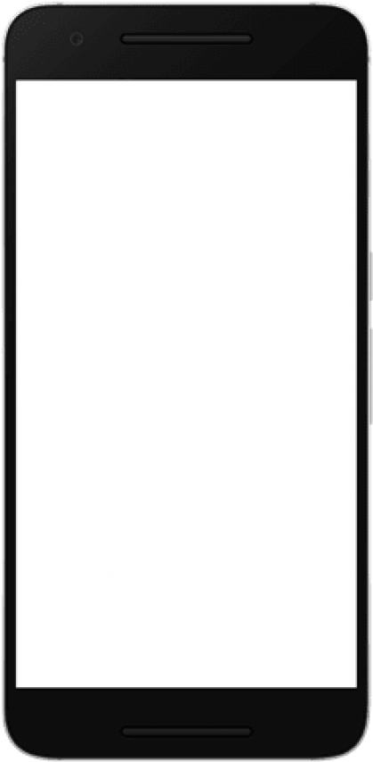

Design of your work
Input: Take a picture
Detection and Recognition.
Translation
हिंदी पाठ
‘हिंदी पाठ’
हिंदी पाठ
‘हिंदी पाठ’
‘Hindi text’
‘Hindi text’
‘Hindi text’
Translated product
Final output

Slide 5
Name the algorithms used if any.
The Detection module is done by using EAST model with CRAFT algorithm. CRAFT algorithm enables the model to find characters with close affinity with respect to their positions.
Non maximal suppression technique used for minimizing boundary box loss.
Recognition module uses CRNN Architecture consisting of a Bi-directional LSTM and ResNet with a CTC loss function to minimize loss.

Slide 6
What is the portion you have completed so far?
Completed Work:
Detection using EAST model.
Recognition using ResNet, LSTM, and CTC loss function
Translation using custom made Translate API
Initial stages of mobile application
65%

Slide 7
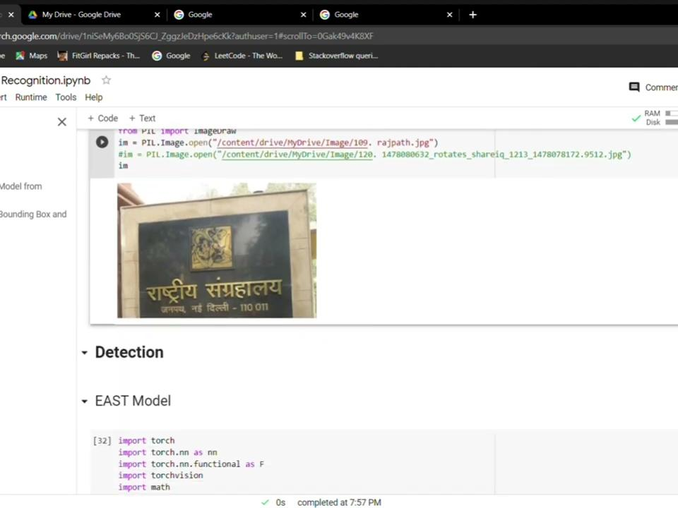
A short video less than a minute to show the working of your code and execution.

Slide 8
Role of each project member.
Srijeyarankesh J S - Developing a detection and recognition module to detect the textual regions(bounding box) in the image and recognise the text present in it with reasonable accuracy.
Kevin Paul C G - Created a translator model to take the given detected text and use a GToken key to develop translated text accordingly and then send output text to our backend server side.
Vishwa Kumar S - Designed a mobile application that allows the user to upload an image from gallery or capture a picture which will be parsed and translated. The translated image will be saved in the history.

Slide 9
Innovation in your work.
Automatic detection of text region thus the user doesn’t have to bother about cropping the image accurately around the text.
We are also planning on adding additional support for other vernacular languages in India to provide a wholesome experience.

Slide 10
Are you satisfied with your work. If yes, why? If no, why?
YES.
We always had the idea to create an Android app which could be of use to this society and this seemed like a perfect opportunity.
We learnt about integration of mobile app development, various other Machine Learning models and optimization algorithms.
We were able to overcome hurdles and find solutions which gave us a positive outlook towards the end.

Slide 11
Self evaluation - on 25, how will you evaluate your own work. Why?
23/25
PROS:
An advanced OCR Translator Mobile Application which is complex but very convenient for daily use.
An embedded model filled with applications from Machine Learning and Mobile Development to create a sophisticated end product.
CONS:
Aesthetic elements can be further developed to build a even more user friendly UI
Accuracy of model is not perfect. Errors are capable.

